Slide 1

Superstore Sales Performance Dashboard
A Business Analytics Project using Microsoft Excel
By Srishti Singh

Slide 2
Objective
Project Goal: To analyze sales data from a fictional retail company to identify patterns, trends, and insights using Excel — helping make informed business decisions.
Key Questions:
Who are our best customers?
Which products and categories are the most profitable?
How do discounts affect profit

Slide 3
Dataset Overview
Dataset: Superstore Sales Data Records: ~9,900 Key Columns:
Order Date, Ship Date
Segment, Region, State
Category, Sub-Category, Product Name
Sales, Quantity, Discount, Profit
Data Cleaning Performed:
Removed duplicates and blanks
Extracted Month, Year
Calculated Days to Ship
KPI:
total Profit= | 2297201
total Profit= | 286397
avg daysToShip= | 3.96
avg order value= | 458.4316
unique customers = | 795

Slide 4
Tools & Techniques Used
Excel Tables for structured data
Pivot Tables & Pivot Charts
Scatter Plot with Trendline (Discount vs Profit)
Formulas: SUMIFS, AVERAGEIFS, COUNTIFS, TEXT, IF, INDEX MATCH
KPI Cards for Total Sales, Profit, Orders
Slicers & Timelines for interactivity

Slide 5
Insights & Visuals
Key Insights:
Consumer segment leads in revenue, but Home Office has better margins
Discounts above 20% often lead to negative profit
California, New York, and Texas dominate in sales
Technology category has high sales but low margins

Slide 6
Segment revenue

Slide 7
Profit vs Discount

Slide 8
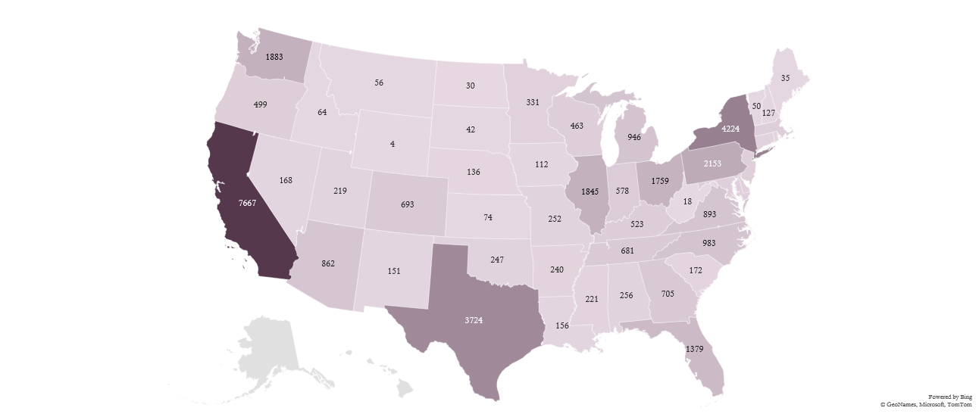
Heat-Map of Quantity sold by states

Slide 9
top-performing categories

Slide 10
Sales by region

Slide 11
Profit by Quantity sold

Slide 12
Top 10 customers
Customer’s Names | Sum of Sales
Adrian Barton | 14473.571
Christopher Conant | 12129.072
Hunter Lopez | 12873.298
Ken Lonsdale | 14175.229
Raymond Buch | 15117.339
Sanjit Chand | 14142.334
Sanjit Engle | 12209.438
Sean Miller | 25043.05
Tamara Chand | 19052.218
Tom Ashbrook | 14595.62

Slide 13
How does shipping mode affect delivery time?
Shipment Mode | Average of daysToShip
First Class | 2
Same Day | 0
Second Class | 3
Standard Class | 5

Slide 14
Monthly sales trends

Slide 15
Monthly Sales Trends (Line Chart)
General Trend: The overall monthly sales are increasing, as shown by the dotted trend line.
Fluctuations:
Lowest Point: February shows the lowest sales.
Sharp Rises: Noticeable increases in March, September, and November.
Drops: After March and September, there's a visible dip (April and October respectively).
Strong Finish: November and December record the highest monthly sales, peaking around 350,000+.
Conclusion: Despite ups and downs, the year ends stronger than it started, indicating positive growth momentum.

Slide 16
Yearly sales trends

Slide 17
Yearly Sales Trends (Bar Chart)
Overall Growth: Sales are steadily increasing year-over-year.
2014: 484,247.50
2015: 470,532.51 (slight dip)
2016: 609,205.60 (strong recovery)
2017: 733,215.26 (continued rise)
Observation:
Only 2015 experienced a slight decline compared to 2014.
Post-2015, the growth has been consistently upward.
Conclusion: Long-term trend is clearly positive, showing strong sales performance improvement over the years.

Slide 18
Business Questions Answered:
Which customer segment generates the most revenue?
Consumer segment has generated the most revenue sharing 50% revenue of total sales.
What are the top-performing categories and products?
Technology is top-performing category.
How do discounts impact profitability?
Discount above 20% often lead to negative profits.
Which regions and states generate the highest/lowest sales?
California, New-York and Texas are leading States, and we can see the west region has highest sales and south region has lowest sales.

